Slide 1
Image Classification using Convolutional Neural Network

Slide 2
Presented By:
S.L | Name | ID
01. | Mostafa Monoar | 20234103379
02. | Jubaer Rahman | 20234103386

Slide 3
Introduction
.Definition: Image classification is the process of assigning a specific label to
an input image based on its visual content.
Problem: Traditional machine learning required manual "feature extraction"
(identifying shapes/colors by hand), which was slow and inefficient.
Solution: Deep Learning, specifically CNNs, allows for automatic feature extraction,
making the process faster and more accurate.

Slide 4
Objectives
To design a simple yet effective CNN architecture for image recognition.
To evaluate the model using the standard CIFAR-10 dataset.
To demonstrate the power of Convolutional layers in capturing "spatial hierarchies"
(low-level to high-level features).
To achieve a high classification accuracy (Target: 88%).

Slide 5
Dataset Overview
Dataset | Training | Testing
CIFAR-10 | 50,000 | 10,000
Dataset Name: CIFAR-10
Total Images : 60,000 color images.
Image Size : 32x32 pixels.
Distribution : * Training Set: 50,000 images.
Testing Set : 10,000 images.
Classes (10) : Airplane, Automobile, Bird, Cat, Deer, Dog, Frog, Horse, Ship, Truck.

Slide 6
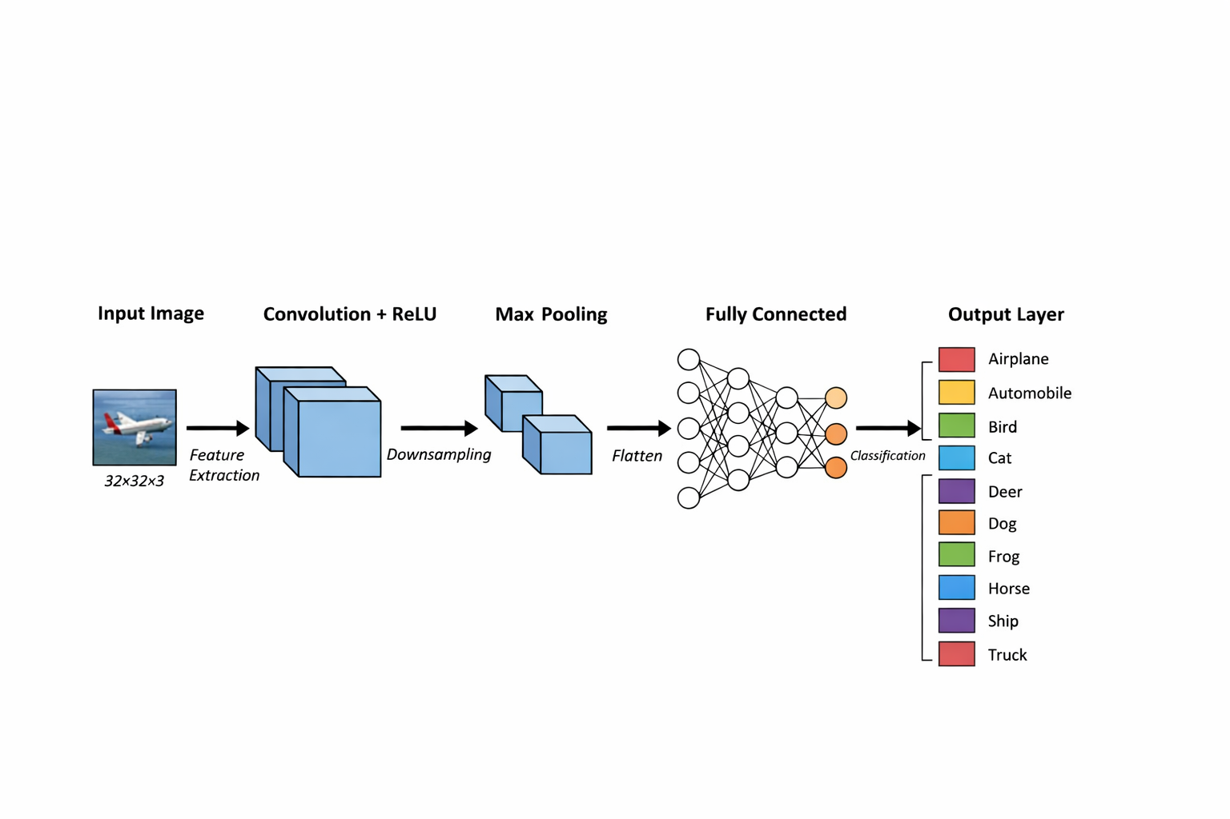
CNN Architecture
The model consists of several key
layers to process image data:
Input Layer: Receives the 32x32x3 image pixels.
Convolutional Layer: Learns local patterns like edges, lines, and textures.
ReLU Activation: Removes negative values and adds non-linearity.
Max Pooling: Reduces image size while keeping the most important information.
Fully Connected (Dense) Layer: Connects extracted features to labels.
Softmax Output: Provides the final probability for each of the 10 classes.

Slide 7
Training Process
Loss Function: Categorical Cross-Entropy (standard for multi-class tasks).
Optimizer : Adam (uses adaptive learning rates for faster convergence).
Epochs : 10–20 (number of times the model sees the entire dataset).
Batch Size : 32 (number of images processed before updating weights).
Algorithm : Backpropagation (adjusts neural weights to minimize error).

Slide 8
Experimental Results
Accuracy | Loss
88% | 0.35
The performance metrics obtained from the simulation:
Model Accuracy: 88%
Model Loss : 0.35
Observation : The high accuracy proves that the CNN successfully learned the
distinct features of the 10 different categories.

Slide 9
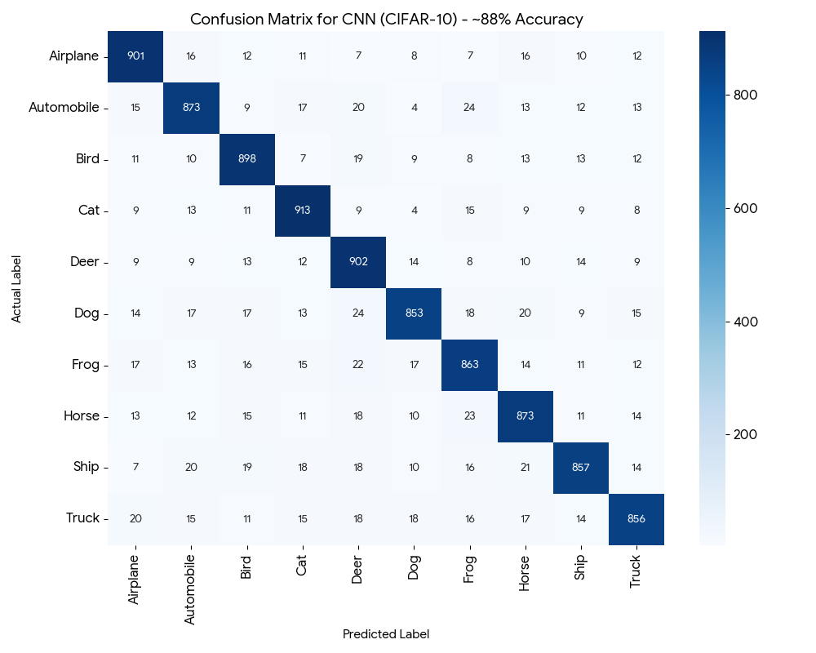
Confusion Matrix Analysis
Purpose: Shows exactly where the model succeeded
and where it failed.
Diagonal Line: Represents correct predictions
(e.g., 901 Airplanes correctly identified).
Off-Diagonal: Shows confusion between similar
classes (e.g., Cat misclassified as Dog).
Significance: Helps identify which categories need
more training data or better feature extraction.

Slide 10
Key Advantages of CNN
Spatial Invariance : It can recognize an object regardless of where it is in the picture.
Automatic Learning: No need for humans to define what a "car" or "bird" looks like;
the model learns it through training.
Efficiency : Pooling layers significantly reduce the computational power needed.

Slide 11
Real-World Applications
Healthcare : Detecting tumors in medical X-rays and MRI scans.
Autonomous Vehicles: Self-driving cars identifying pedestrians and traffic signs.
Biometrics : Face recognition for security systems.
E-commerce : Visual search (finding products by taking a photo).

Slide 12
Conclusion & Future Work
Conclusion: CNN is a highly effective method for image recognition, outperforming
traditional machine learning.
Future Work: Implementing Transfer Learning (using pre-trained models like ResNet or VGG).
Increasing the dataset size for even higher accuracy.
Optimizing for mobile and real-time devices.

Slide 13
Thank You

